Slide 1



INTRODUCTION TO DATA VISUALIZATION
TEAM T_05
CHICAGO CRIME REPORT
DEVANG CHOUDHARY 202418016
SUJAL DHRANGDHARIYA 202418017
MANISH 202418030
KASHISH PATEL 202418044
Instructor
Prof. Bhaskar Chaudhury

Slide 2
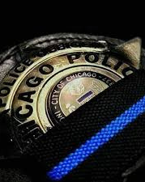
AGENDA
Chicago vs. Other Cities
What happened ?
Where did it happened ?
When did it happened ?
Why Did It Happen?
Conclusion

Slide 3
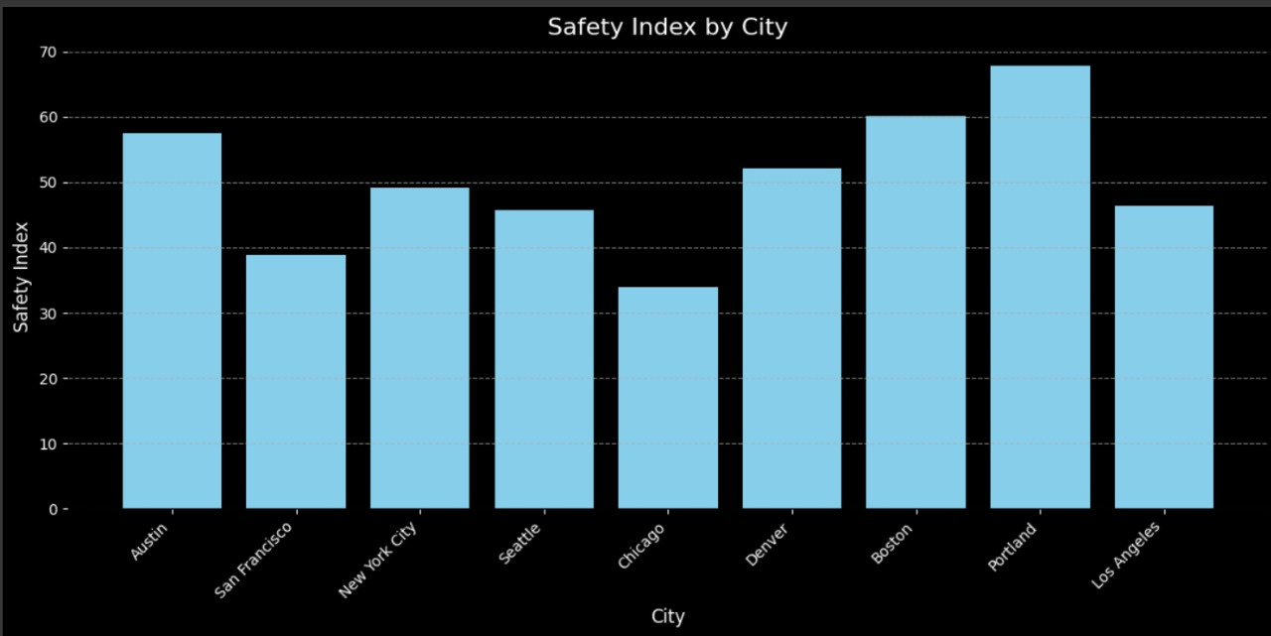
Chicago has one of the lowest safety index values among the compared cities.
Cities like Portland, Boston, and Austin scored significantly higher on safety.
This indicates a perception of higher crime or lower public safety in Chicago.

Slide 4
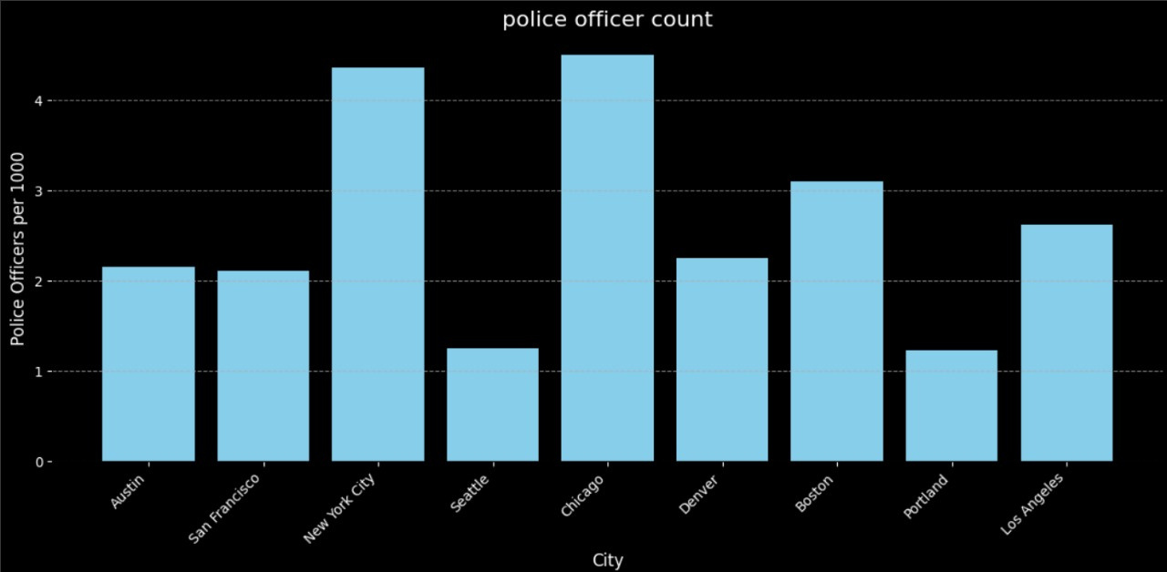
Interestingly, Chicago has the highest number of police officers per 1,000 people.
Yet, despite a strong police presence, the safety perception remains low.

Slide 5
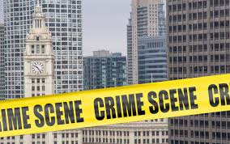
CHICAGO VS. OTHER CITIES
Chicago has one of the largest police forces per capita in the U.S., which should imply strong public safety.
Yet, the city ranks low in perceived safety. Many communities still face crime and residents report feeling unsafe.
Is it about policing strategies — or deeper social and economic issues?
Tourist count for chicago is approx 50 Million per year.
Let’s explore this by comparing cities on two key measures:
Perceived Safety
Police Presence

Slide 6

HYPOTHESIS : 1
Certain locations have higher incidents of specific crime types
HYPOTHESIS : 2
Crime Rates Vary by Month and Season

Slide 7

WHAT HAPPENED ?
OVERVIEW ANALYSIS OF CHICAGO CRIME

Slide 8
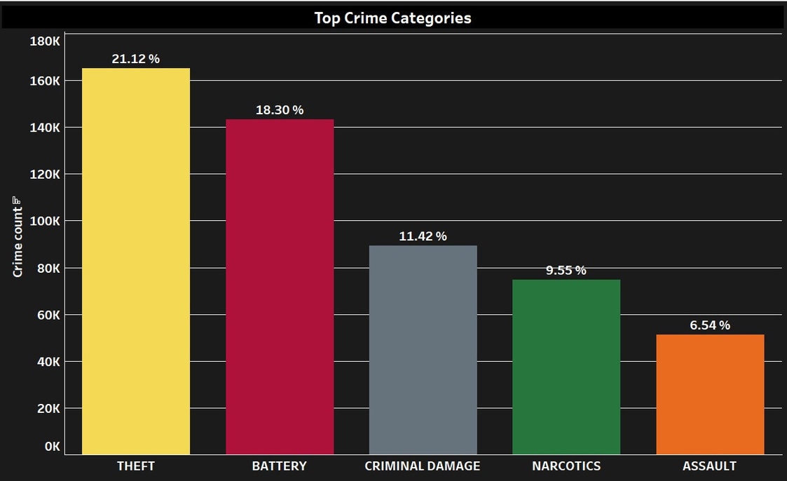
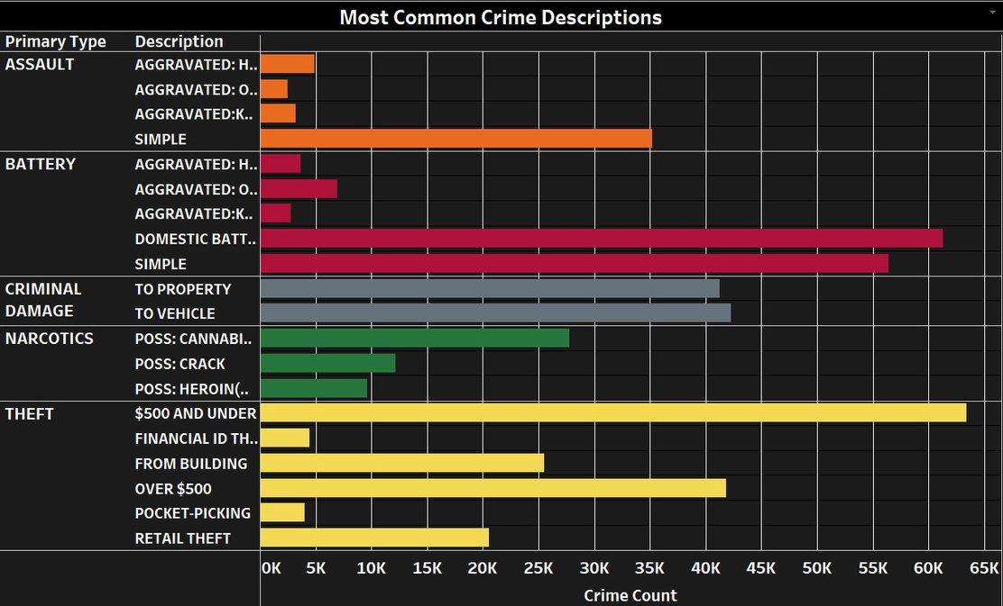
Top 5 crime categories
Breakdown Of crime categories

Slide 9
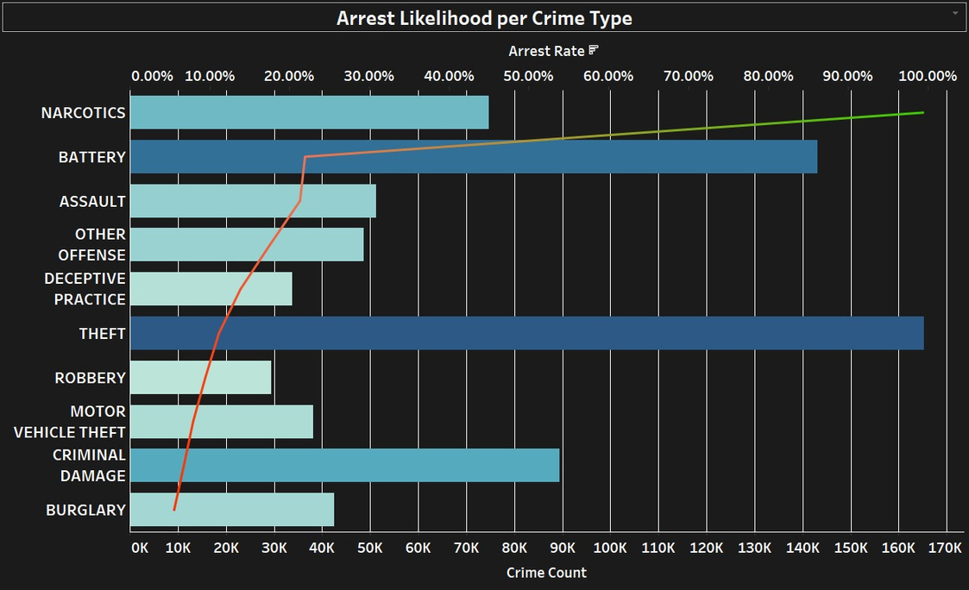
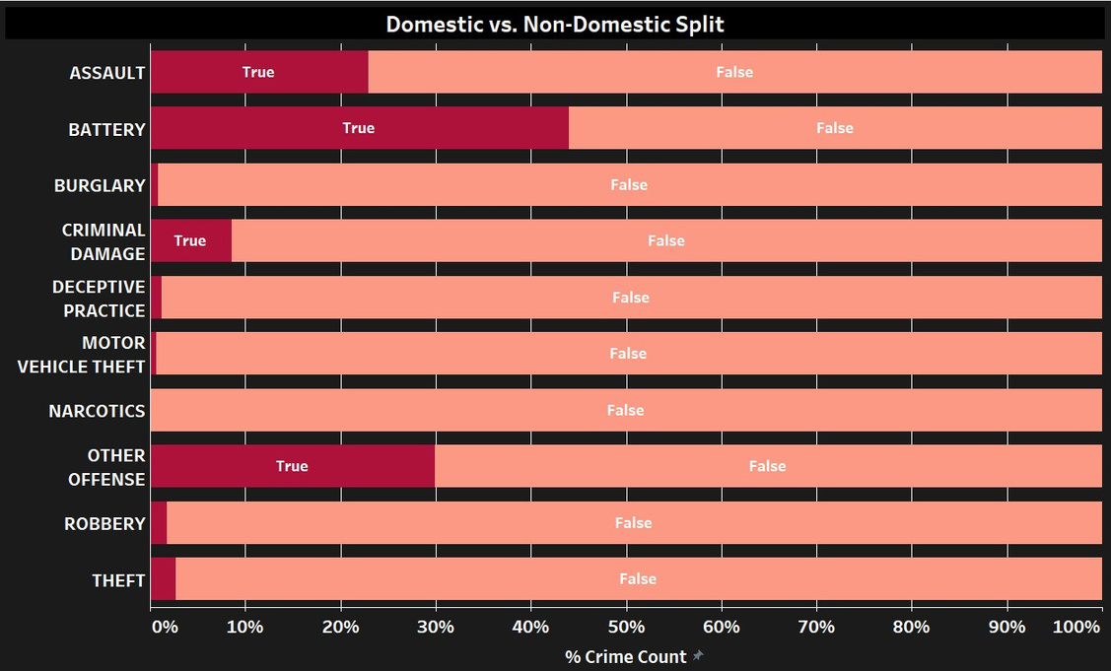

Slide 10
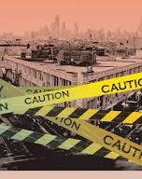
WHERE DID IT HAPPEN ?
A GEOGRAPHIC ANALYSIS OF CRIME INCIDENTS

Slide 11
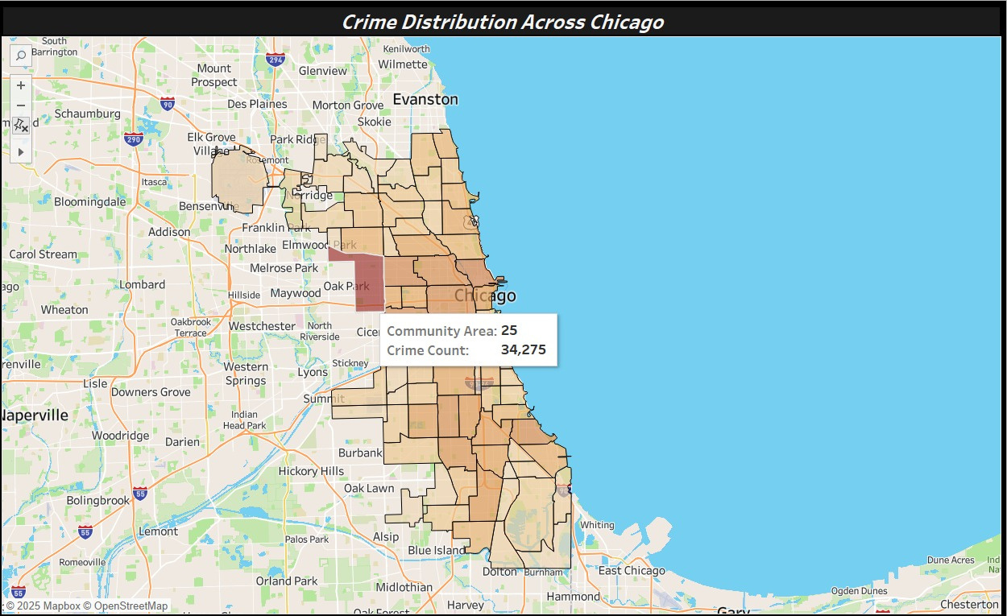
Central and West Chicago show darker intensity, indicating higher crime rates
Crime distribution is not uniform across the city

Slide 12
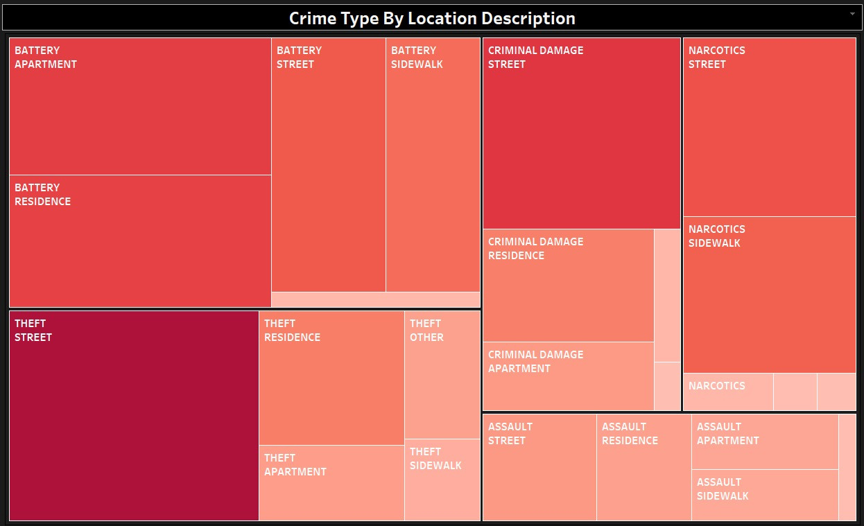
Helps in identifying environmental triggers for different crime categories

Slide 13
KEY TAKEAWAYS
The environment plays a key role in crime type occurrence — Theft thrives in public places, while Battery tends to happen in more private or domestic settings.
Street-related crimes suggest a need for increased public surveillance and patrolling.
The strong presence of Narcotics and Assault on sidewalks may indicate drug-related street activity or disputes.

Slide 14

WHEN DID IT HAPPEN ?
A FORENSIC LOOK AT CRIME TIMELINES

Slide 15
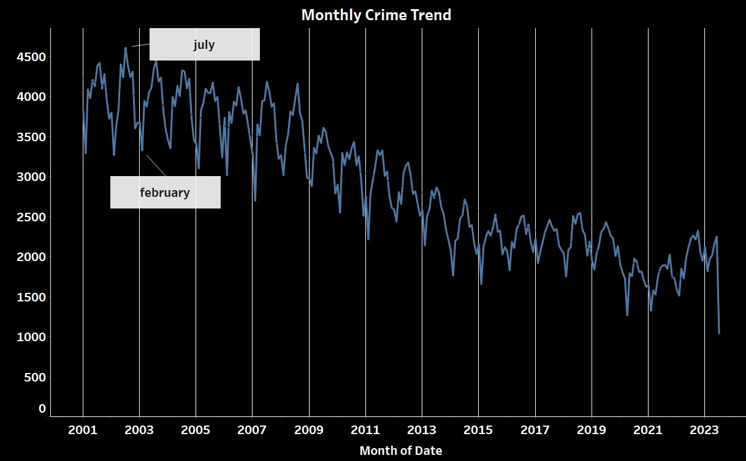
Monthly trend in crime across the years

Slide 16
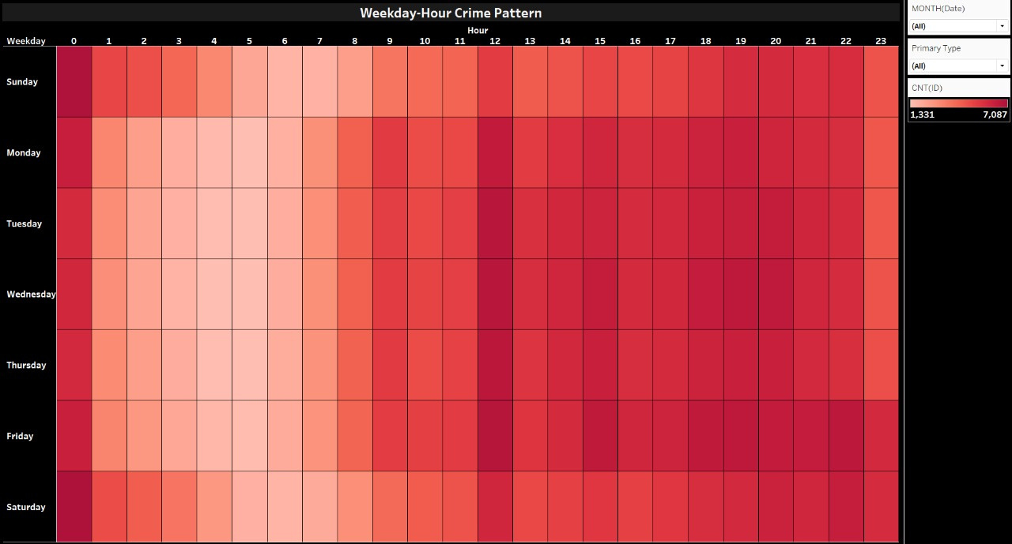
As expected crime peaks during evening hours

Slide 17
KEY TAKEAWAYS
Crime follows a recurring pattern
Crimes peak consistently in summer months (especially July & August) across years.
Evening hours (12 PM – 11 PM) show the highest crime activity on all days.
Weekend days records the most number of crimes, particularly during late hours.

Slide 18
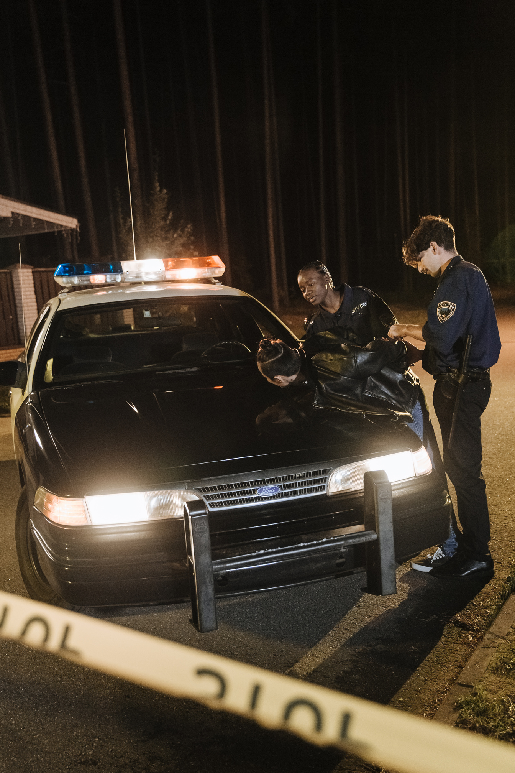


WHY DID IT HAPPEN ?
THE FORCES THAT DRIVE OFFENDERS

Slide 19
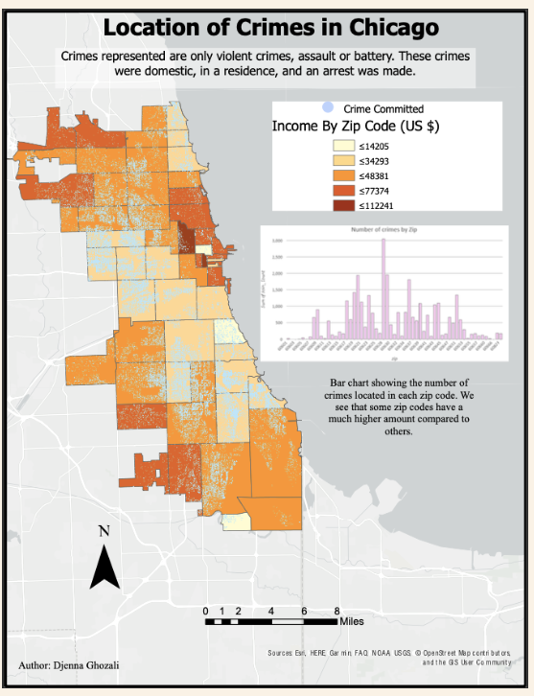

Slide 20
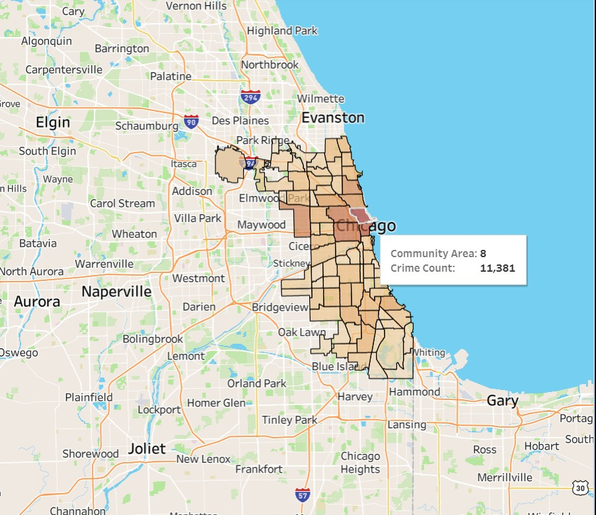
Areas with low median household income (e.g., <$30K) face significantly higher crime rates.
West and South Side neighborhoods show both low income and high crime.
North Side areas with higher income (> $80K) have lower crime.
High income community = more number of Theft
Poverty and crime are cyclical: crime discourages investment, which deepens poverty.
Gentrification effect : Crime falls with investment & development

Slide 21
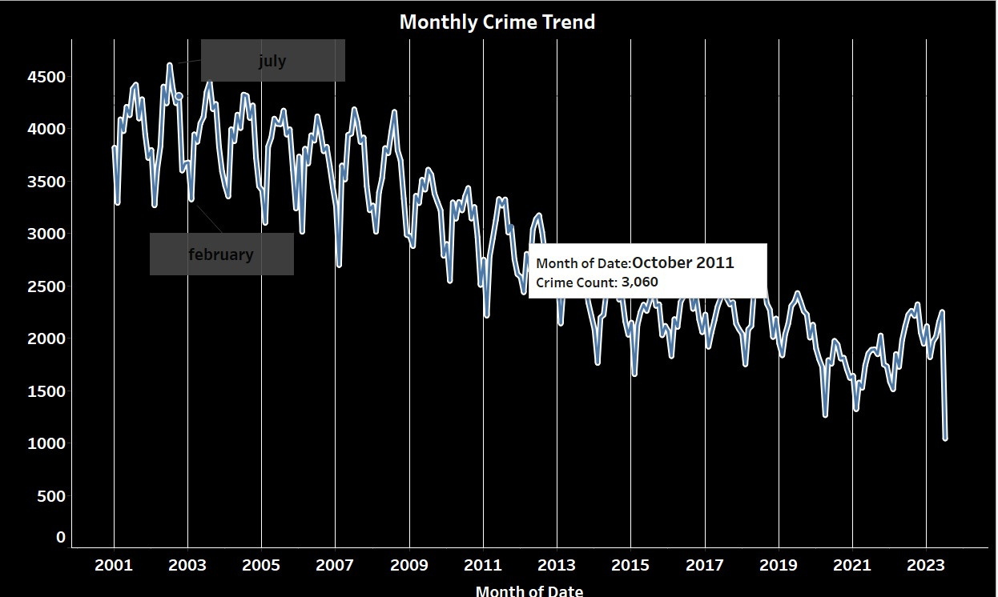
Warmest Month July
Summer surge: 38% of more crime in summer.
Coldest Month February.
Winter dip: Cold weather = fewer street crimes
October = collection month for winter season.
Routine Activity Theory: Crime = Offender + Target – Guardian
Weather impact: Hot = ↑ violence, cold = ↓ street activity
Exceptions: Domestic violence, retail theft (Dec. holidays)

Slide 22





CONCLUSION
Crime in Chicago is driven by clear patterns in time and location, deeply linked to poverty, environment, and social factors. Effective future action requires smart policing during high-risk hours, targeted investment in disadvantaged areas, expansion of youth and social programs, and the use of data to guide proactive, community-based crime prevention strategies.

Slide 23
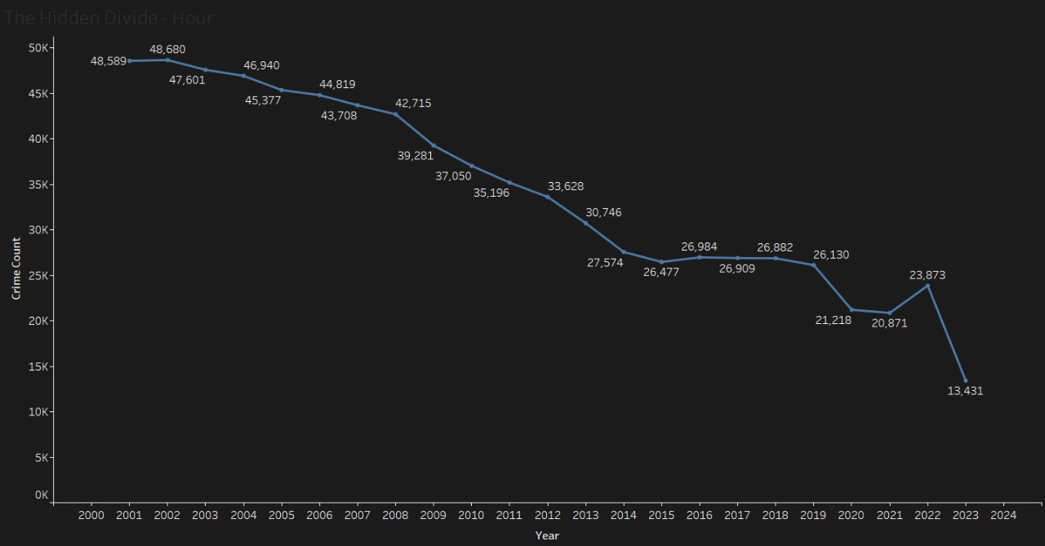
Despite the challenges Chicago has faced with violent crime and arrest rates, there are promising signs of progress. Over the past decade, total reported crimes have decreased by 29%, reflecting the city's resilience and ongoing efforts to enhance public safety. This decline offers hope and underscores the potential for further improvements in creating a safer Chicago for all its residents.

Slide 24

THANK YOU

